Slide 1


Slide 2
Create project
Stages
Moving between stages
Commit
Branch
Moving between branches
Create new branch
Server
HEAD
merge
Detached head state
Fast forward
fetch
Copy project
origin
push
GitHub

Slide 3
Create project
Git Areas
Moving between stages
Commit
Branch
Moving between branches
Create new branch
HEAD
merge
Detached head state
Fast forward

Slide 4
Agenda
Why do we need a source control?
How does Git save our project history internally?
Introduction to Git areas
Git merge operation
Most asked questions about local work

Slide 5
1. Why do we need a source control?
Backup
Backup
Backup
Backup
A search tool
A merge tool
A distributed solution for remotely working together.

Slide 6
Sections
Basics of Git
Logging
Deep dive

Slide 7
Full tutorial on Gist.Github.com
https://gist.github.com/stavalfi/1020abe20960c2daf215410da56250eb

Slide 8
Most asked questions
My push failed because someone pushed before I did. Why it failed?
I’m in detached head state. What do I do?
How do I edit a friend’s code written in a specific time in history?
How do I merge my friend’s code to my code?
I’m not ready to commit but must checkout to other branch. What do I do?
I’m not ready to push but my friend want to merge some of my code. What should we do?
I merged and got too much conflicts. I don’t know what to do. How do I abort the merge?
Should we use a new commands we didn’t learn today?

Slide 9
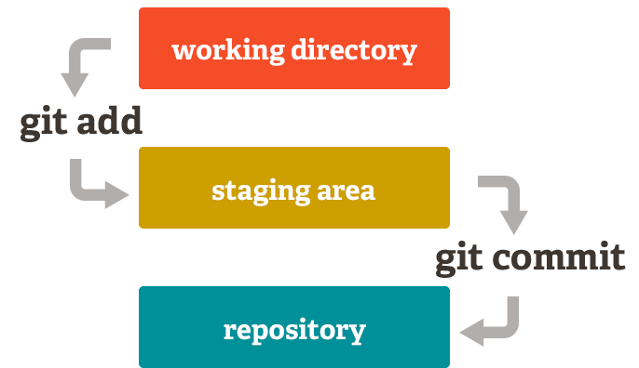
Part 1 – Git Basics

Slide 10
186f45e
35g6dr
45rf78

Slide 11
7546dr
05ed8r
186f45e
35g6dr
45rf78

Slide 12
master
186f45e
35g6dr
45rf78

Slide 13
bug1
master
7546dr
05ed8r
186f45e
35g6dr
45rf78

Slide 14
bug1
master
7546dr
05ed8r
HEAD
186f45e
35g6dr
45rf78

Slide 15
Merges
Rebase
Remote

Slide 16
Merges
Why
How
Conflicts and aborting

Slide 17
bug1
5
1
2
3
4
git merge bug1
master
HEAD

Slide 18
bug1
5
6
1
master
2
3
4
git merge bug1
HEAD

Slide 19
Git merge bug1 //ERROR: CONFLICT in file xyz.txt git add xyz.txt git commit –m “this is the commit of the merge”
///////////////////
Master
//////////////////
…
…
…
///////////////////
bug1
//////////////////
…
…
…

Slide 20
Part 2
Rebase
Rebase - Going deeper
Remotes

Slide 21
Rebase
What is it
How
Conflicts and aborting
Best practice when you have merging conflicts – Avoid containing changes in the merging commits. Rebase will ignore that commit anyway.
Going deeper

Slide 22
bug1
HEAD
5
1
2
3
4
Git rebase master
master

Slide 23
bug1
HEAD
1
2
3
4
5’
Git rebase master
master

Slide 24
Rebase - Going deeper
When to use
Cherry-picking
Detached Head State
Use with caution

Slide 25
Remote
Clone
Fetch – Does not do any new local commits
Push – Conditions: Fast-forward and updates
Pull – Fetch with specific and a single merge – don’t use

Slide 26
Don’t rebase everything

Slide 27
remote/dev
local/dev
remote/dev
local/dev
8
Stav: git fetch
7
6
4
5
2
3
2
local/bug1
1
Stav
1
bar

Slide 28
remote/dev
local/dev
remote/dev
local/dev
8
8
Stav: git checkout local/dev
7
7
6
6
4
5
5
3
2
2
local/bug1
1
Stav
1
bar

Slide 29
remote/dev
local/dev
remote/dev
local/dev
8
8
Stav: git merge remote/dev
Stav: git rebase local/bug1
7
7
6
6
4
5
5
3
2
2
local/bug1
1
Stav
1
bar

Slide 30
remote/dev
local/dev
remote/dev
local/dev
8
8’
8
7’
Stav : git checkout local/bug1
7
6’
7
6
5’
6
4
5
5
3
2
2
local/bug1
1
Stav
1
Bar

Slide 31
remote/dev
local/dev
remote/dev
local/dev
8
8’
8
7’
Stav : git merge local/dev
Stav : git checkout local/dev
7
6’
7
6
5’
6
4
5
5
3
2
2
local/bug1
1
Stav
1
Bar

Slide 32
remote/dev
local/dev
remote/dev
local/dev
8
8’
8
7’
Stav : git merge remote/dev
7
6’
7
6
5’
6
4
5
5
3
2
2
local/bug1
1
Stav
1
Bar

Slide 33
remote/dev
local/dev
remote/dev
local/dev
8
8’
8
7’
9
7
6’
7
6
5’
6
4
5
5
3
2
2
Stav: git branch –d local/bug1
Stav : git push remote local/dev
local/bug1
1
Bar
Stav
1

Slide 34
remote/dev
local/dev
remote/dev
local/dev
8
8’
8
7’
9
7
6’
7
6
5’
6
4
5
5
3
2
2
Bar: git fetch
1
Bar
Stav
1

Slide 35
remote/dev
local/dev
remote/dev
local/dev
8
8’
8
8’
7’
7’
9
9
7
7
6’
6’
6
5’
6
5’
4
4
5
5
3
3
2
2
1
1
Stav
Bar

Slide 36
remote/dev
local/dev
4
remote/dev
3
8
9
8
local/dev
7
7
6
6
4
Good solution with rebase
5
5
3
Good solution with merge
2
2
1
Bar
1
Bar

Slide 37
Conclusions so far
Rebase – Not for everything

Slide 38
5. Most asked questions about local work
Restoring a previous version of your project
I’m in detached head state. What do I do?
How do I edit my friend’s code which is written in a specific time in history?
How do I merge my friend’s code to my code?
I merged and got too much conflicts. I don’t know what to do. How do I abort the merge?
What shouldn’t be saved in Git repository?
How to delete a commit?

Slide 39
Topics we didn’t cover about local work
1. How to really control what gets into a merge commit?
2. How to move to a different branch when I have staged work?
3. How to replace a commit with a different content?
4. How to see differences between the content of 2 branches/commits?
5. How to search in Git history?

Slide 40
Subject we didn’t cover about remote server
Save our commits and branches in a remote server = git push
Getting commits which our friends made from the server = git fetch
What is branch protection?
What is a pull request and why do we need it?
What are Git WebHooks and how we communicate between Bitbucket & Jenkins (Both directions)

Slide 41
Most asked questions
My push failed because someone pushed before I did. Why it failed?
I’m in detached head state. What do I do?
How do I edit a friend’s code written in a specific time in history?
How do I merge my friend’s code to my code?
I’m not ready to commit but must checkout to other branch. What do I do?
I’m not ready to push but my friend want to merge some of my code. What should we do?
I merged and got too much conflicts. I don’t know what to do. How do I abort the merge?
Should we use a new commands we didn’t learn today?

